Slide 1
UVa 10104 Euclid Problem

Slide 2
UVa 10104 Euclid Problem (Time Limit: 3 seconds)
Given two positive integers A and B, find two integers X and Y such that A * X + B * Y= GCD(A, B).
A, B < 1000000001
| X | + | Y | is the minimal.
If there are several X and Y satisfying the minimal criteria, output the pair for which X ≤ Y .

Slide 3
Sample Input
Sample Output
Case #1:
4 6
17 17
A, B
-1 1 2
0 1 17
X, Y, GCD
Case #2:
Case #1:
4 * (-1) + 6 * 1 = GCD(4, 6) = 2
Case #2:
17 * 0 + 17 * 1 = GCD(17, 17) = 17
X
Y

Slide 4
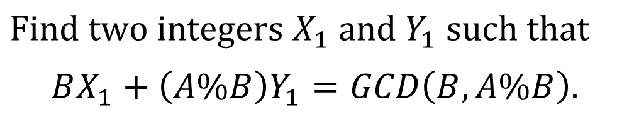

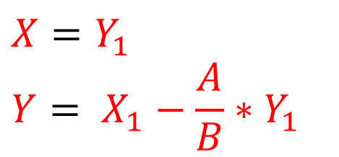
Solution
GCD輾轉相除法, %$:$mod
$$AX+BY=GCD\left(A, B\right)=GCD(B, A\%B)$$
$$X=Y_{1}$$
$$Y= X_{1}−\frac{A}{B}∗Y_{1}$$
A, B
$$Find two integers X_{1} and Y_{1} such that$$
$BX_{1}+\left(A\%B\right)Y_{1}=GCD\left(B,A\%B\right).$

Slide 5
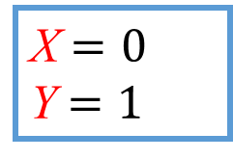
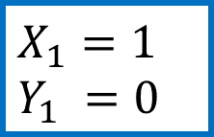
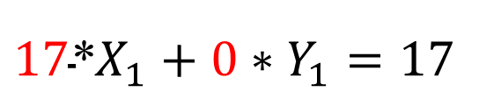
Solution
GCD輾轉相除法, %$:$mod
$$AX+BY=GCD\left(A, B\right)=GCD(B, A\%B)$$
17*X +17*Y = GCD(17,17) = 17=GCD(17,17%17)=GCD(17,0)
$$X=Y_{1}$$
$$Y= X_{1}−\frac{A}{B}∗Y_{1}$$
X$=0$
Y $=1$
A, B
(17,17)
$$Find two integers X_{1} and Y_{1} such that$$
$BX_{1}+\left(A\%B\right)Y_{1}=GCD\left(B,A\%B\right).$
$$X_{1}=1$$
$$Y_{1} =0$$
$${\text{17}\text{∗}X}_{1}+0∗Y_{1}=17$$
17 * 0 + 17 * 1 = GCD(17, 17) = 17

Slide 6

Solution
$$AX+BY=GCD\left(A, B\right)$$
Recursive solution
If B = 0, then X = 1 and Y = 0.
( A * 1+ 0 * 0 = GCD(A, 0) = A )

Slide 7

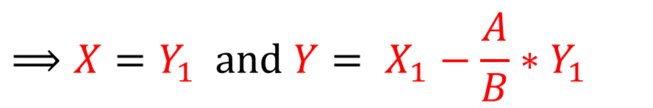
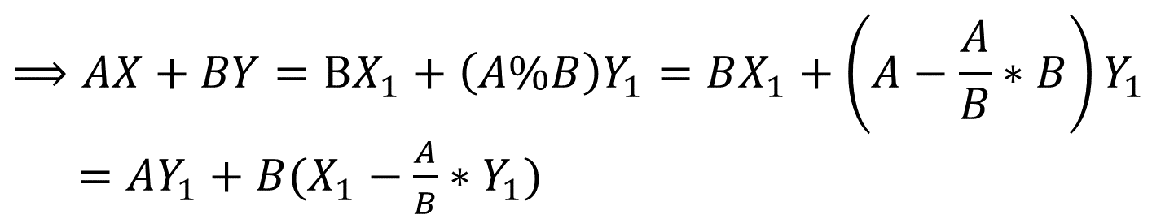
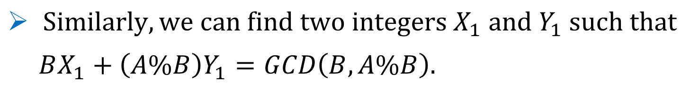
Solution
$$AX+BY=GCD\left(A, B\right)$$
If B ≠ 0,
$AX+BY=GCD\left(A, B\right)=GCD(B, A\%B)$
GCD輾轉相除法, %$:$mod
$Similarly, we can find two integers X_{1} and Y_{1} such that$
$BX_{1}+\left(A\%B\right)Y_{1}=GCD\left(B,A\%B\right).$
$$⟹AX+BY=BX_{1}+\left(A\%B\right)Y_{1}=BX_{1}+\left(A−\frac{A}{B}∗B\right)Y_{1}$$
$=AY_{1}+B(X_{1}−\frac{A}{B}∗Y_{1})$
$$⟹X=Y_{1} and Y= X_{1}−\frac{A}{B}∗Y_{1}$$

Slide 8

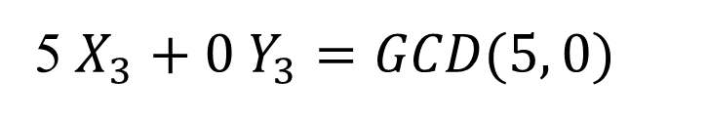
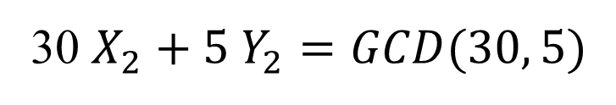
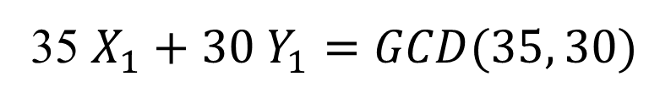
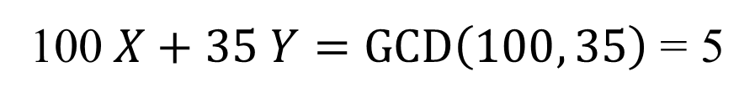
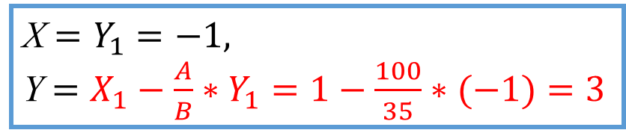
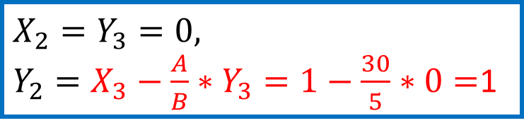
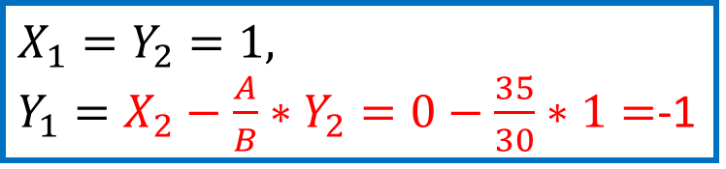
Example: A = 100, B = 35
X$=Y_{1}=−1,$
Y $=X_{1}−\frac{A}{B}∗Y_{1}=1−\frac{100}{35}∗(−1)=3$
100$X+35 Y=GCD\left(100, 35\right)$= 5
GCD(35, 100%35)
= GCD(35, 30)
$$X_{1}=Y_{2}=1,$$
$Y_{1}=X_{2}−\frac{A}{B}∗Y_{2}=0−\frac{35}{30}∗1=$-1
35 $X_{1}+30 Y_{1}=GCD(35, 30)$
GCD(30, 35%30)
= GCD(30, 5)
$$X_{2}=Y_{3}=0,$$
$Y_{2}=X_{3}−\frac{A}{B}∗Y_{3}=1−\frac{30}{5}∗0=$1
30 $X_{2}+5 Y_{2}=GCD(30, 5)$
GCD(5, 30%5)
= GCD(5, 0)
5 $X_{3}+0 Y_{3}=GCD(5, 0)$
$X_{3}=1, Y_{3}=0$
Output: -1 3 5

Slide 9
#include <iostream>
using namespace std;
int x,y;
int extend_gcd(int a,int b)
{ if (b==0) { x=1;y=0; return a; }
else { int ans=extend_gcd(b,a%b);
int tmp=y;
y=x-a/b*y;
x=tmp;
return ans;
}
}
int main()
{ int a,b;
while (cin>>a>>b)
{ int d=extend_gcd(a,b); cout<<x<<" "<<y<<" "<<d<<endl; }
return 0;
}
Program

